Slide 1
Neural Substrates of Attention and Awareness
Dan Birman
Gardner Lab
Kalanit Lab Meeting – 2015-02-06
Notes:
Okay! I’m interested in attention/awareness, but these are often ill-defined. I’m going to use an example to get the ideas across.

Slide 2


Notes:
Show animation, then go back and repeat: asking to attend to background (21 total black dots move, 22 with the first)
Point here is that you have no AWARENESS of the changes in the first attempt, while you’re attending to the dots. But you need very little additional attention to notice them. No bottom-up attention = inattentional blindness

Slide 4
Notes:
Now it’s obvious

Slide 5
Attention as a Pre-Requisite to Awareness
Dual task designs “pull” attention to one task, causing inattentional blindness for other stimuli.
“we believe […] there is no conscious perception without attention” (Mack & Rock, 1998)
“The close relationship between attention and
consciousness has led many scholars to conflate these
processes“ (Koch & Tsuchiya, 2006)
Mack & Rock, 1998

Slide 6
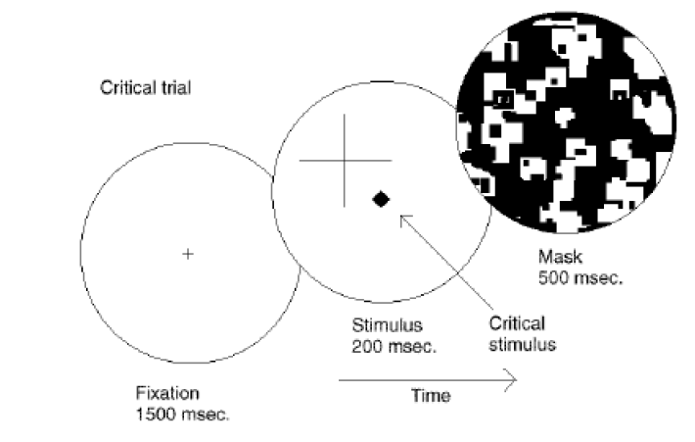
Attention as a Pre-Requisite to Awareness
Dual task designs “pull” attention to one task, causing inattentional blindness for other stimuli.
“we believe […] there is no conscious perception without attention” (Mack & Rock, 1998)
Mack & Rock, 1998
Notes:
There is one situation where attention (seems) to not be a pre-requisite for awareness

Slide 7
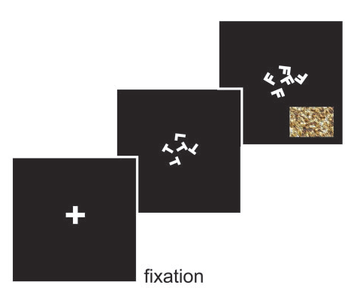
Gist Perception
“The close relationship between attention and
consciousness has led many scholars to conflate these processes“ (Koch & Tsuchiya, 2006)
Li et al., 2002
Reddy et al., 2004

Slide 8

Gist Perception
Li et al., 2002
Reddy et al., 2004

Slide 9
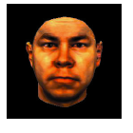
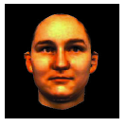
Gist Perception
Li et al., 2002
Reddy et al., 2004

Slide 10
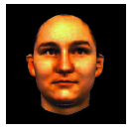
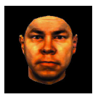
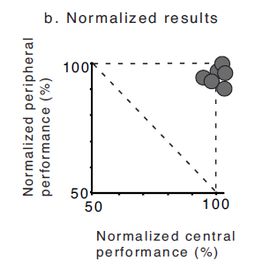
Gist Perception
Li et al., 2002
Reddy et al., 2004
Notes:
Note: dual task performance NORMALIZED by single task performance

Slide 11
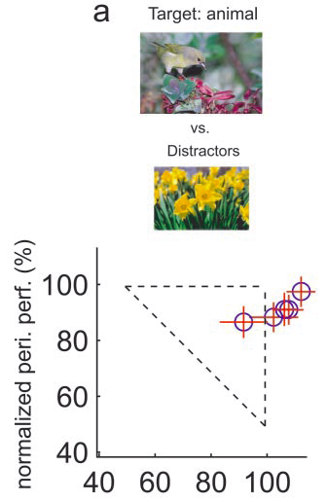
Gist Perception
Li et al., 2002
Reddy et al., 2004

Slide 12
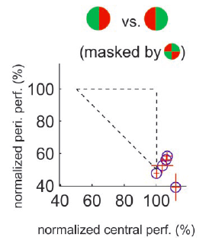
Gist Perception
F
L
F
F
F
F
Li et al., 2002
Reddy et al., 2004
Notes:
Note the whole story… what if the central task was not difficult enough? Or maybe it didn’t “interfere” with the other task?

Slide 13
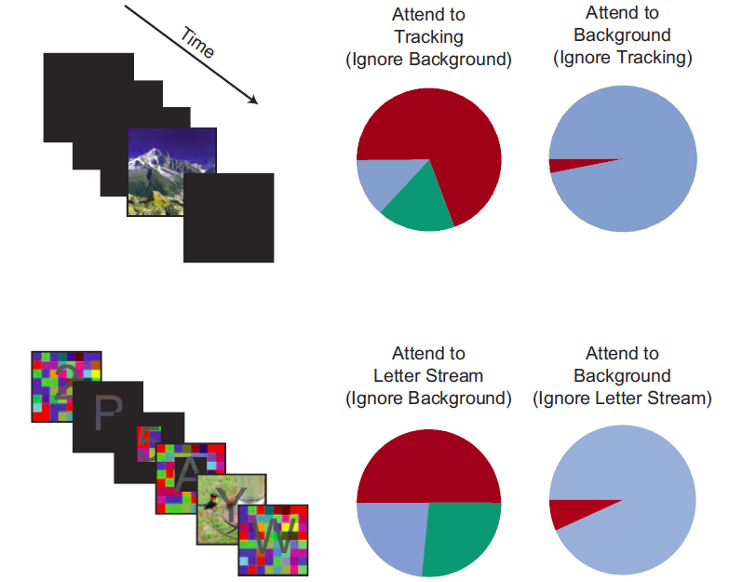
Gist Perception: Impossible Under Load?
Blind
Classified
Saw
Cohen et al., 2011
Notes:
Some tasks DO interfere enough to inhibit awareness. No awareness without attention. So is attention the precursor to awareness?

Slide 14
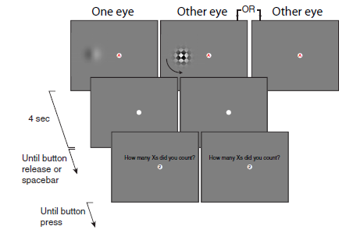
Attempts to Dis-Entangle Attention/Awareness
Dual Task Designs where attention is crossed with awareness. How does a dependent measure, e.g. afterimage length, depend on these factors?
van Boxtel et al., 2010
Notes:
Maybe attention is a pre-cursor to awareness. How might we show that? One idea is to dissociate attention and awareness.
Note: awareness manipulated with a mask or no mask, attention manipulated using secondary task

Slide 15
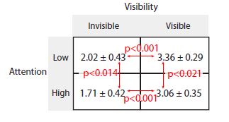
Attempts to Dis-Entangle Attention/Awareness
Afterimage Length (s)
van Boxtel et al., 2010
Notes:
Note that there is no bottom-up confound for visibility, since the expected effect is in the wrong direction
Other problems: do we really understand how binocular suppression works? Does it act at the right “stage” of processing?
Ultimately: we shouldn’t be talking about all kinds of attention and awareness equally, we need to be more specific to solve this question

Slide 16


Operational Definitions vs. Neural Activity
http://www.globeimages.net/data/media/180/berlin_cathedral_front.jpg
Notes:
So far we’ve run on the assumption that ‘attention’ and ‘awareness’ are two “things” that we intuitively understand. Attention guides and awareness brings into our perception. But what if this model is incorrect? Attention is a neural process and so is awareness. To understand how attention and awareness interact (if they do) we should look to computational modeling. As an example, think about what happens when you focus on “teal” in the image.

Slide 17
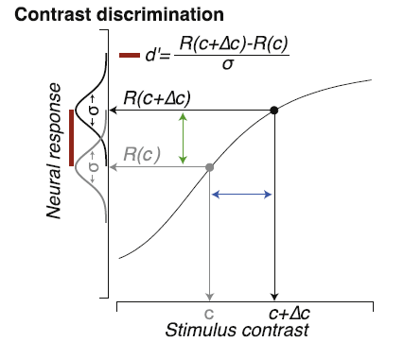
Identifying Neural Substrates
Pestilli et al., 2011

Slide 18
Identifying Neural Substrates
Pestilli et al., 2011
Notes:
Neural response is monotonic increasing according to some function R()

Slide 19
Identifying Neural Substrates
Pestilli et al., 2011

Slide 20
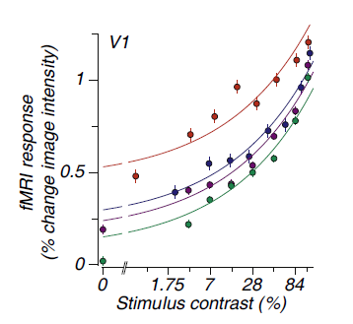
Identifying Neural Substrates
BOLD Magnitude
Pestilli et al., 2011

Slide 21
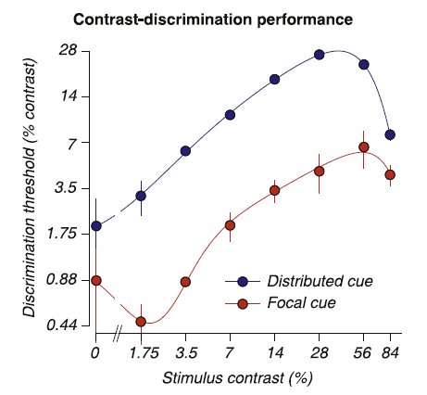
Identifying Neural Substrates
BOLD Magnitude
Pestilli et al., 2011

Slide 22
Identifying Neural Substrates
Behavioral Performance ←→ BOLD Magnitude
Pestilli et al., 2011

Slide 23
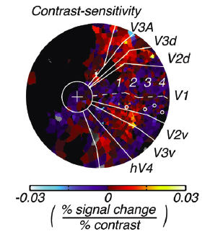
Feature Dependent Neural Substrates
Hara et al., 2014
Tjan et al., 2006

Slide 24
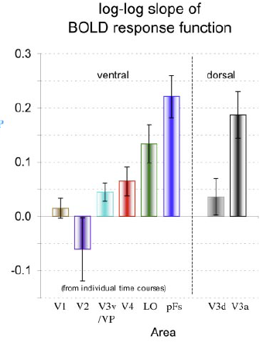
Feature Dependent Neural Substrates
to objects
in noise
Hara et al., 2014
Tjan et al., 2006

Slide 25
Conceptual Overview: Attention & Awareness
“Recent research has slowly corroded a belief that selective attention and consciousness are so tightly entangled that they cannot be individually examined.” (van Boxtel et al. 2010)
Instead of focusing on dissociating attention and awareness, we should be focused on understanding their neural substrates.
Attention: Local feature-specific modulation of neural activity
Awareness: A downstream process, dependent in an uncertain manner on attention.
Computational Modeling:
Notes:
First attempt: dual

Slide 26
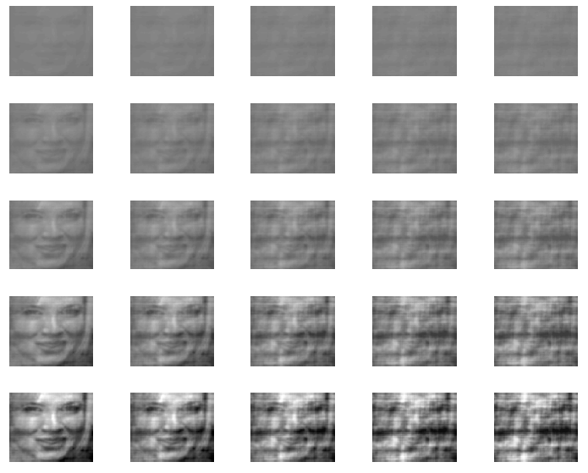
Separating Selective from Spatial Attention
Contrast
Noise
Notes:
Spatial attention causes a robust boost in activation in that region, does feature attention operate in a similar way? Feature attention may be robust (e.g. for scenes) even when spatial attention is deployed elsewhere. We should be careful to separate these in our experiment.

Slide 27


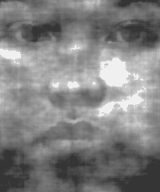


Notes:
Discriminate contrast OR noise: spatial attention crossed with feature attention, which is important for awareness?

Slide 28

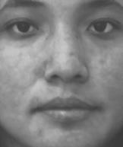
Notes:
High (dual) vs. Low (single) task conditions. Expectation: During dual task contrast/gender will have better performance than noise/gender, because noise attention is more feature-based than contrast which is more spatial.

Slide 29
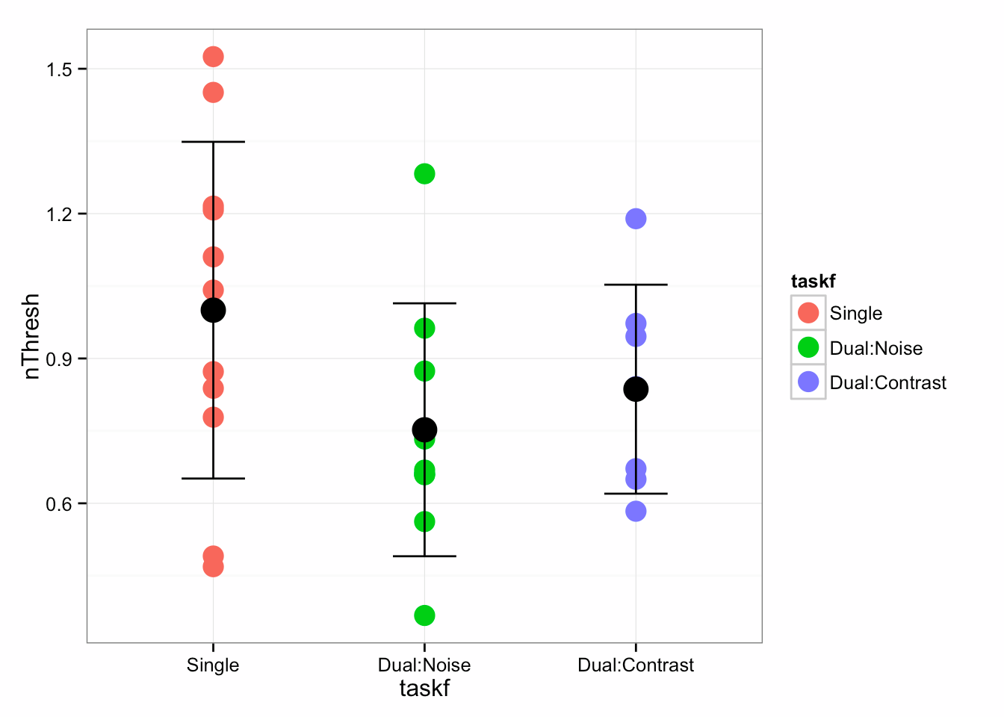
Attention * Awareness
Notes:
Gender same across all categories

Slide 30
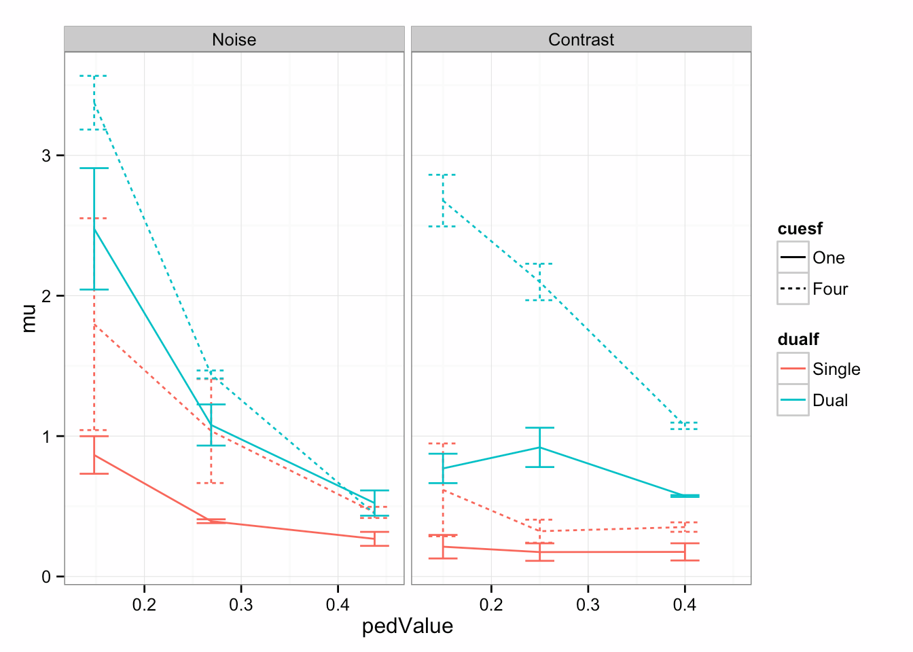
Attention * Awareness
Notes:
Remember to talk about your prediction: noise + gender = worse performance, contrast + gender = better performance

Slide 31
Dual Task Issues
Difficulty: Previous Slides contain >10,000 trials (7s per trial)
Cross-task Comparisons (noise threshold vs. contrast threshold?)
Cross-task interference: Hard to control which task is the ‘main task’ and which task has deteriorating performance.
Bottom-up vs. top-down attentional effects

Slide 32





Possible solution: Graded Change Blindness?
Less prone to bottom-up attentional effects
No training required
Signal detection rather than forced choice discrimination: allows for a measurement of “awareness” in the direct sense.
Still separates effects of spatial and feature attention on awareness.
Catch trials: Measuring awareness
In the absence of top-down attention
Notes:
We really care about top-down attention

Slide 33
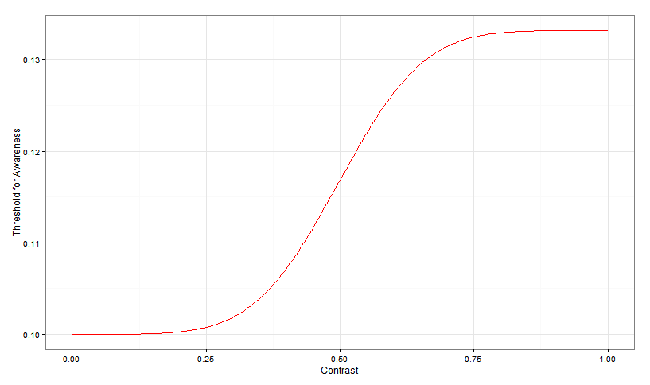
Expectations
Ped C

Slide 34
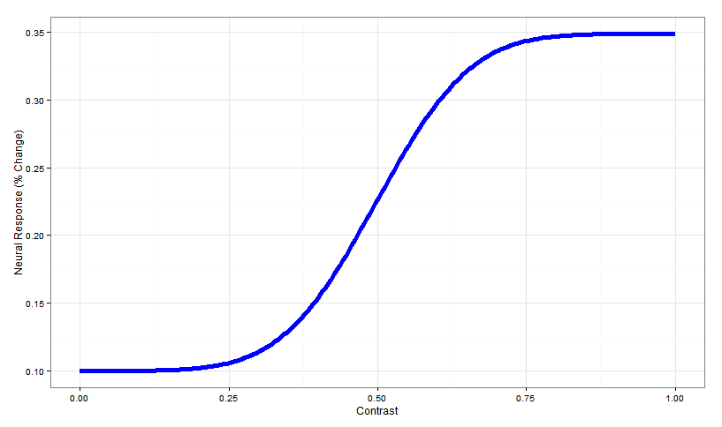
Expectations
Ped C

Slide 35
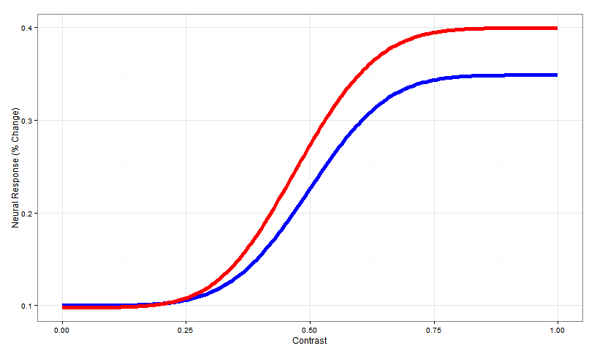
Expectations
Change in slope
due to attention
Ped C

Slide 36
Expectations
Can a (plausible) model of awareness, as a function of neural activity, capture the behavioral results in dual tasks?
Or do we need additional steps to explain how awareness can occur in the absence of “attention” (e.g. spatial attention) in some circumstances and not in others?
Change in slope
due to attention
Ped C

Slide 37




Gardner Lab @ Stanford University
Justin Gardner
Steeve Laquitaine
Thanks for your attention and awareness!

Slide 38
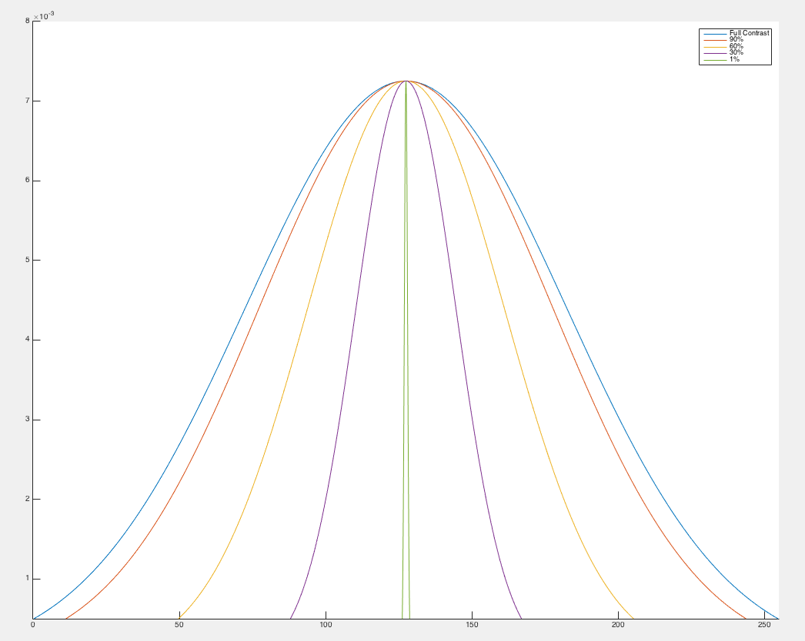
Manipulating Contrast

